Slide 1
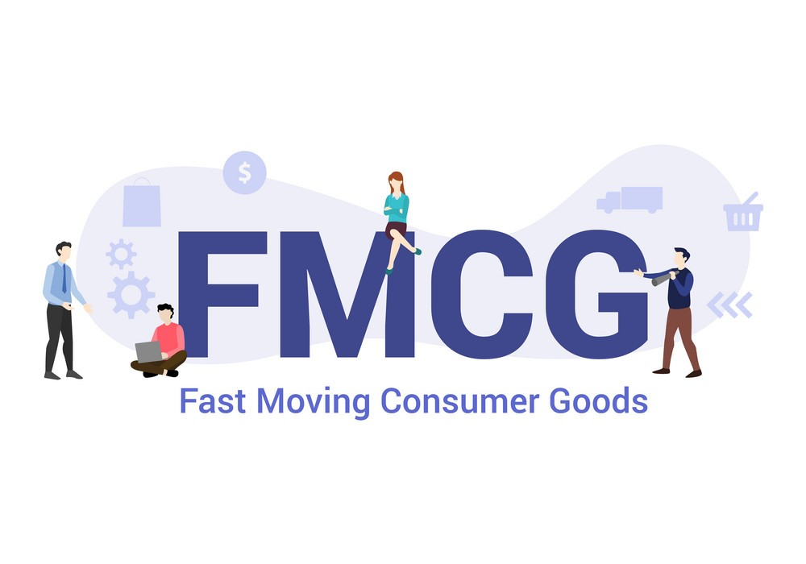
FAST MOVING CONSUMER GOODS(FMCG)

Slide 2
INTRODUCTION:
Fast-moving consumer goods (FMCG) sector is India's fourth-largest sector with household and personal care accounting for 50% of FMCG sales in India.
Growing awareness, easier access and changing lifestyles have been the key growth drivers for the sector.
Fast-moving consumer goods are products that sell quickly at relatively low cost. These goods are also called consumer packaged goods.
FMCGs have a short life because of high consumer demand or because of they are perishable.

Slide 3
SPREAD AND GROWTH OF FMCG IN INDIA:
FMCG is the fourth largest sector in the Indian Economy.
The growth rate has shot up automatically from $30 billion to projected $74 billion between 2011 and 2018.
The FMCG market in India generated revenues worth USD 47.3 billion in 2015.
IN 2017,revenue for FMCG sector reached USD 50 billion.
FMCG market in India is expected to grow at a CAGR of 20.6% and is expected to reach US $103.7 billion by 2020 from US $49 billion in 2016.
The rural FMCG market in India is expected to grow at a CAGR of 14.6% and reach US $220 billion by 2025 from US $29.4 billion in 2016.

Slide 4
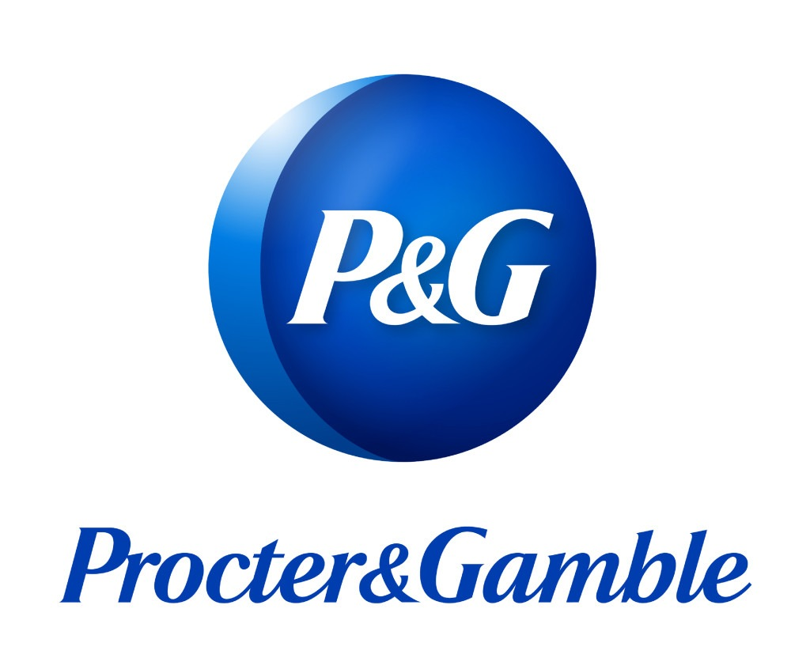

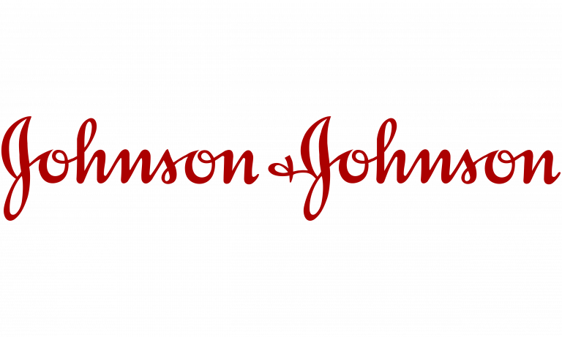

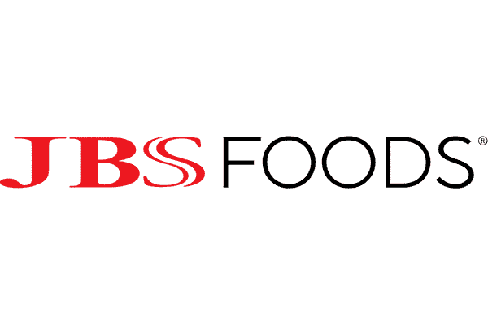


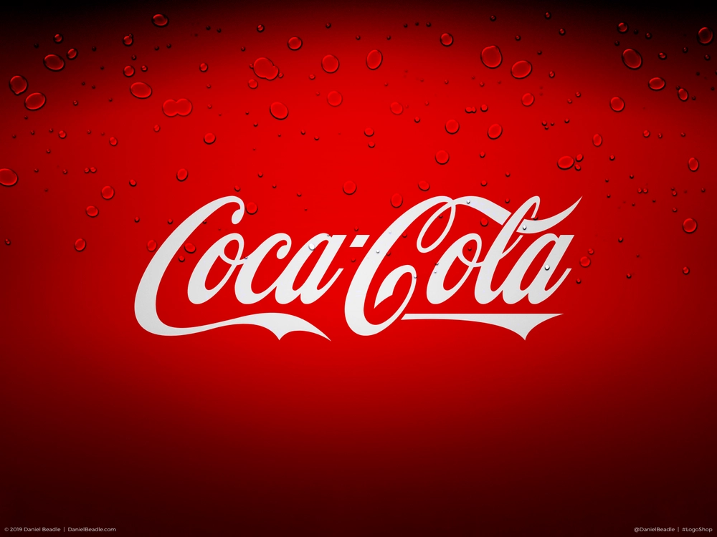
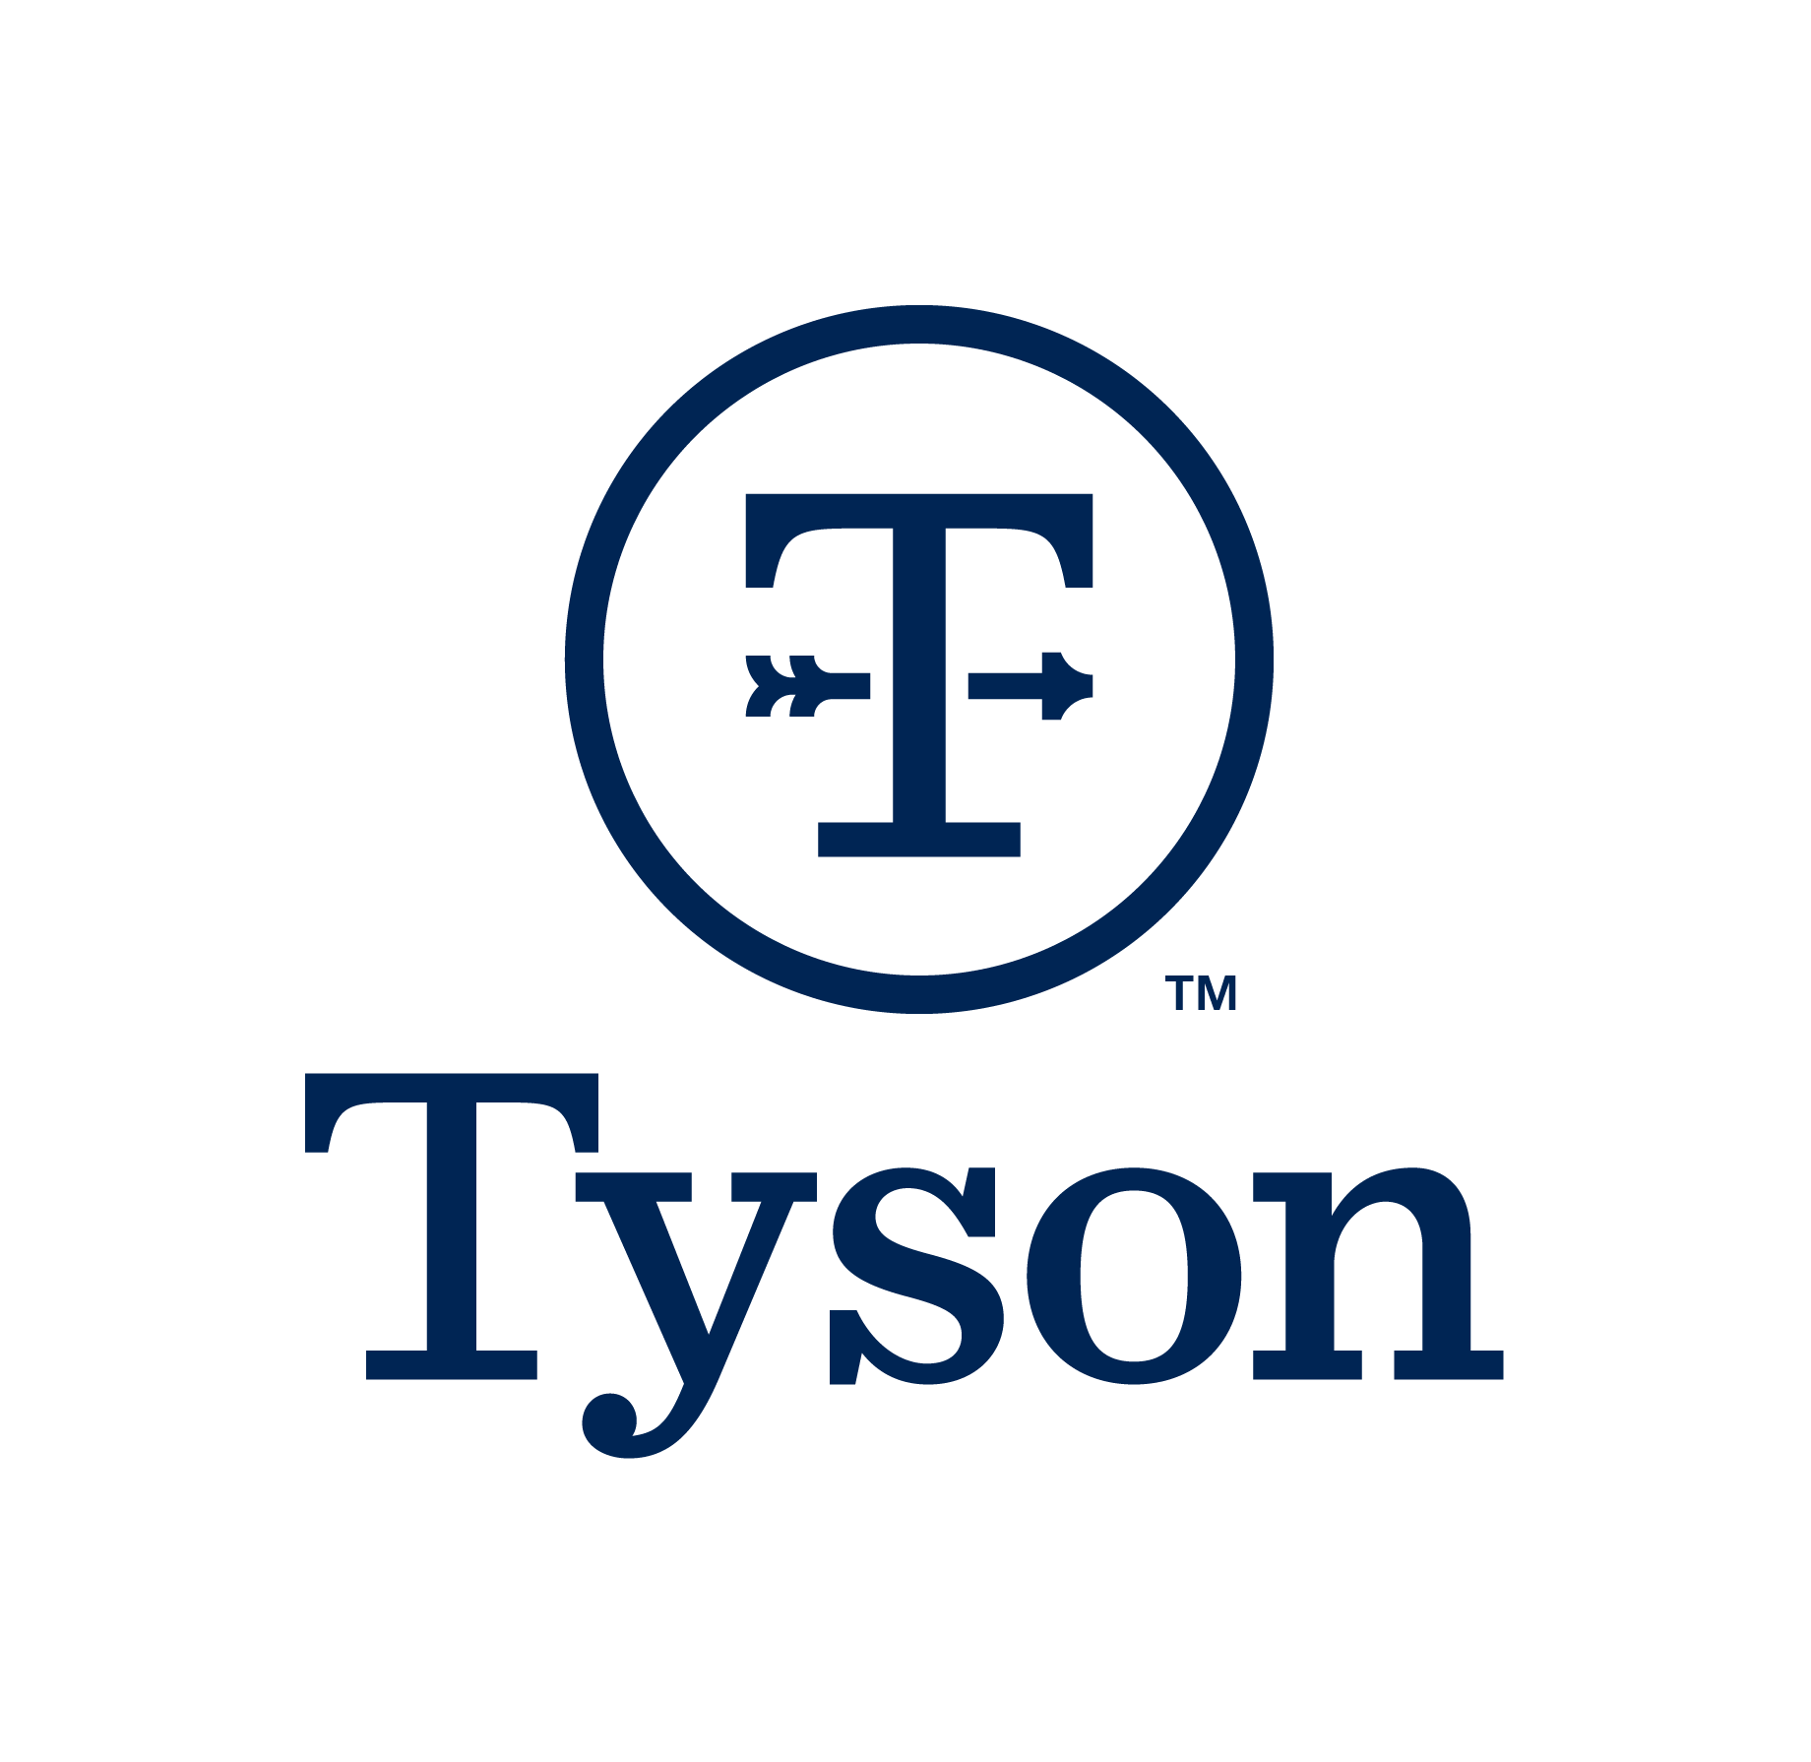

TOP 10 FMCG COMPANIES :

Slide 5
TOP FIVE FMCG PRODUCTS IN WORLDWIDE :
1)Johnson & Johnson:
Headquarter-New Brunswick ,New Jersey , United States.
Founder-Robert Wood Johnson & James Wood Johnson in 1885.
Revenue- $93.7 billion
2) Nestle:
Headquarter- Vevey , Switzerland.
Founder-Henri Nestle in 1867
Revenue- $91.4 billion
3) Procter & Gamble:
Headquarter- Cincinnati, Ohio, United States.
Founder- William Procter & James Gamble in1837
Revenue- $77.13 billion
4) Pepsi Co:
Headquarter- Cincinnati, Ohio, United States.
Founder-Caleb Bradham in 1965
Revenue- $76.68 billion
5)JBS Foods:
Headquarter- Harrison , New York , United States.
Founder-Caleb Bradham in 1965
Revenue- $76.68 billion

Slide 6



TOP 3 FMCG COMPANIES IN INDIA:
1)ITC Limited(Imperial Tobacco Company):
Headquarter- Kolkata, India
Establish- In 1910 (Ajit Narain Haksar)
Revenue- $9.8 Billion(74,979 Cr)
2)Hindustan Unilever Limited(HUL):
Headquarter- Mumbai, India
Founder-Lever Brothers in 1933
Revenue- $5.3 Billion(40,415 Cr)
3)Nestle India Limited:
Headquarter- Gurugram , Haryana, India
Establish- In 1959 (CMD Suresh Narayan)
Revenue- $1.7 Billion(12,615 Cr)

Slide 7
DOMESTIC VS. GLOBAL MARKET:
The domestic FMCG market increased 36.9% in April-June 2021.The FMCG market in India is expected to increase at a CAGR of 14.9% to reach US$ 220 billion by 2025.
The global FMCG logistic market size was USD 103.57 billion in 2020. The market is projected to grow from USD 105.85 billion in 2021 to USD 131.54 billion in 2018 at a CAGR of 3.15% during the 2021-2028 period.
Performance cycle: In domestic market, total performance cycle varies in days. However in global market, the performance cycle varies in weeks or months. The reason for a longer performance cycle are communication delays, financing requirement, special packaging requirement, long transportation times and custom clearance.
Documentation: International operations requires multiple documents for goods clearance through customs.
System Integration: This includes the ability coordinate various supply chain processes to fulfil the orders in agreed time frame.
Alliances: International alliances can provide market access and expertise and helps to reduce the risk in global operations.

Slide 8
MARKETING STRATEGIES:
Understand the customer priority.
Analyze the overall FMCG market.
Find the competitors.
Research distribution.
Multi-brand strategy.
New-product development.
Financial analysis.
Sales Promotion and digital marketing.

Slide 9
COVID-19 IMPACT ON FMCG:
According to the study, without the covid-19 impact the market would have grown much slower at 0.8% istead of 5.3% in Urban areas.
In the initial month of lockdown in April and May, the market grew at 3%, hit by supply and distribution disruptions.
In the next- two months, the FMCG market sector saw a growth of 4.8%.
Demand further improved to 5% after the opening- up period of August and September because of demand for hygiene category and in- home snacks.
Overall report says that brands with bigger managed to increase their volume but smaller companies lost volumes.

Slide 10
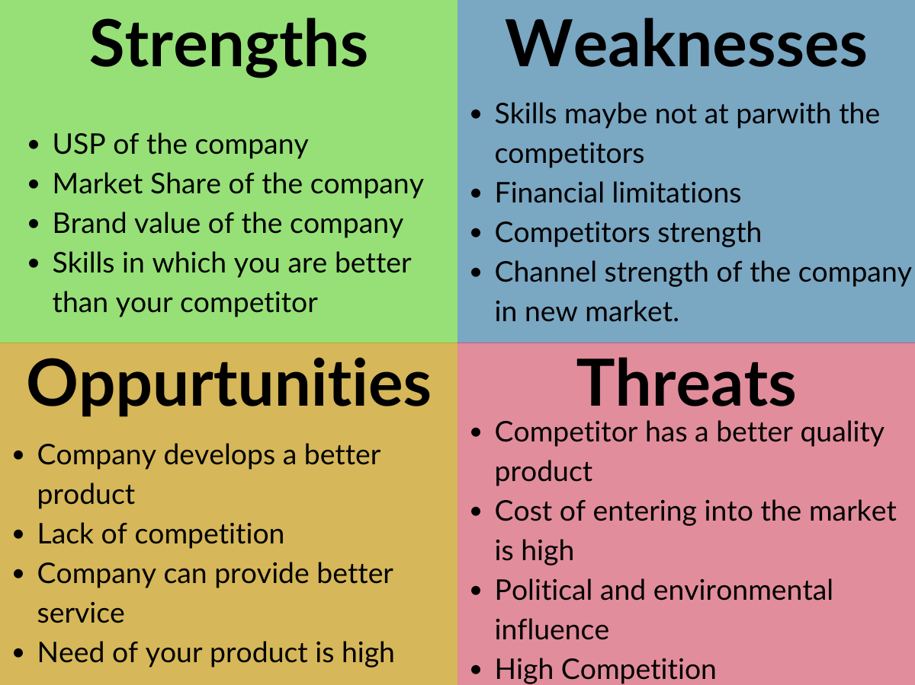
SWOT ANALYSIS:

Slide 11
CONCLUSION:
It is high risk area but with the promise of a large customer following as the prize for those who succeed.
The key to reducing the risk is to understand the market, the consumer need.
Today’s youth embraces spread, they want packaged goods that work better, faster and smarter.
Success of Digital media and new viewing channels like Netflix, Hot Star, Jio Movies have started endangering events driven advertising.
The FMCG will continue to be the cornerstone of Indian Economy.

Slide 12
PARETO PRINCIPLE:
Pareto principle in general is the observation (not law) that most things in life are not distributed evenly. It can mean all things take on “80% VS 20%” relationship like Result VS Inputs, Production VS Workers.
The pareto principle aids in realizing that the majority of results comes from minority of inputs.
This knowledge helps to focus on the key contributors, deviants, customers, technology etc.
The idea is to identify and focus on the attributes that make a difference instead of wasting the energy on the vast majority with minimal outputs.
Putting pareto thinking into practice in Analytics can help to separate high value data with reference to customers, predicts the action for increased customer loyalty and execute the action at the time while optimizing the resources.

Slide 13
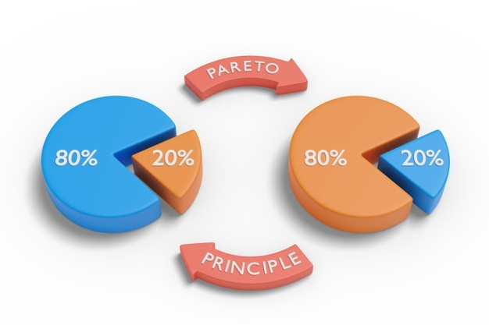
The 80/20 marketing rule or the pareto principle is a marketing concept which highlights that 20% of your effort should reflect 80% of the results. Businesses aim to put in 20% of their efforts to yield desired result which add up to 80%.

Slide 14
BENCHMARKING:
Benchmarking allows you to compare your data with aggregated industry data from other companies who share their data.
This provides valuable context, helping you to set meaningful targets, gain insight into trends occurring across your industry and find out how you are doing compared to your competition.
Benchmarking simply means you set a standard at which you compare something else to.

Slide 15
RESEARCH TECHNIQUES:
Research methods are the strategies, processes or techniques utilized in the collection of data or evidence for analysis in order to collect new information or create better understanding of topic.
Formal approach to do a research is the process by which we learn new information to better understand ourselves, each other and the world with which we interact.

